Slide 1
Customer CRM to ZINFI UPM Integration
Lead Management Best Practices
Ext.prc.002.06 | 08.16.2025
UPM 25.x

Slide 2
The Usual B-to-B Scenario
The well-trodden path to dysfunction and despair

Slide 3








The Usual B-to-B Scenario
Partners want all “leads” fast
Channel Marketing hits the “more” button
Partners don’t follow up
Channel Marketing: “Why no followup?”
Partners: The “leads” are no good
Channel Marketing:
Wasted effort, poor performance, bitterness, despair
Notes:
3

Slide 4





Lead Management Challenges in the Channel
Low Partner Satisfaction
Unclear Distribution Policies
Inadequate Processes/ Technology
Lack of Visibility
Lack of Partner Urgency
Partners have no faith in lead quality
Unclear who should receive a lead
Leads are distributed to partners manually
Difficult to find out what partners do with the leads
Partners do not respond to leads in a timely fashion

Slide 5
6 Ps of End to End
Channel Lead Management
Leveraging Partner Relationship Management (PRM) Automation

Slide 6
6Ps Overview
Key Strategic Items …
Define a vision and governance processes to improve visibility
Better cross-functional alignment between sales & marketing
Baseline current performance and identify key revenue drivers
Criteria for capturing, tracking and measuring partner performance
Mitigate risks manage via SLAs and lead acceptance criteria
Now I will show you how to drive this tactically …
Policies: Partner Profiles & Access Rights
Platform: Supplier Led & Partner Led
Process: Lead Distribution & Management
People: Concierge Services
Programs: Marketing & Sales Incentives
Performance: Tracking, Measuring & Rewarding

Slide 7









Channel Lead Policies
Partner Access Rights Management
Access Rights by Groups
Varied Rules
  Admin = accepts & distributes
  Marketing = nurtures
  Sales = qualifies & registers
Time Based Events
  SMB < 7 Days
  Mid-Market < 90 days
  Enterprise < 180 days
Partner medallion status
Industry vertical
Partner users

Slide 8
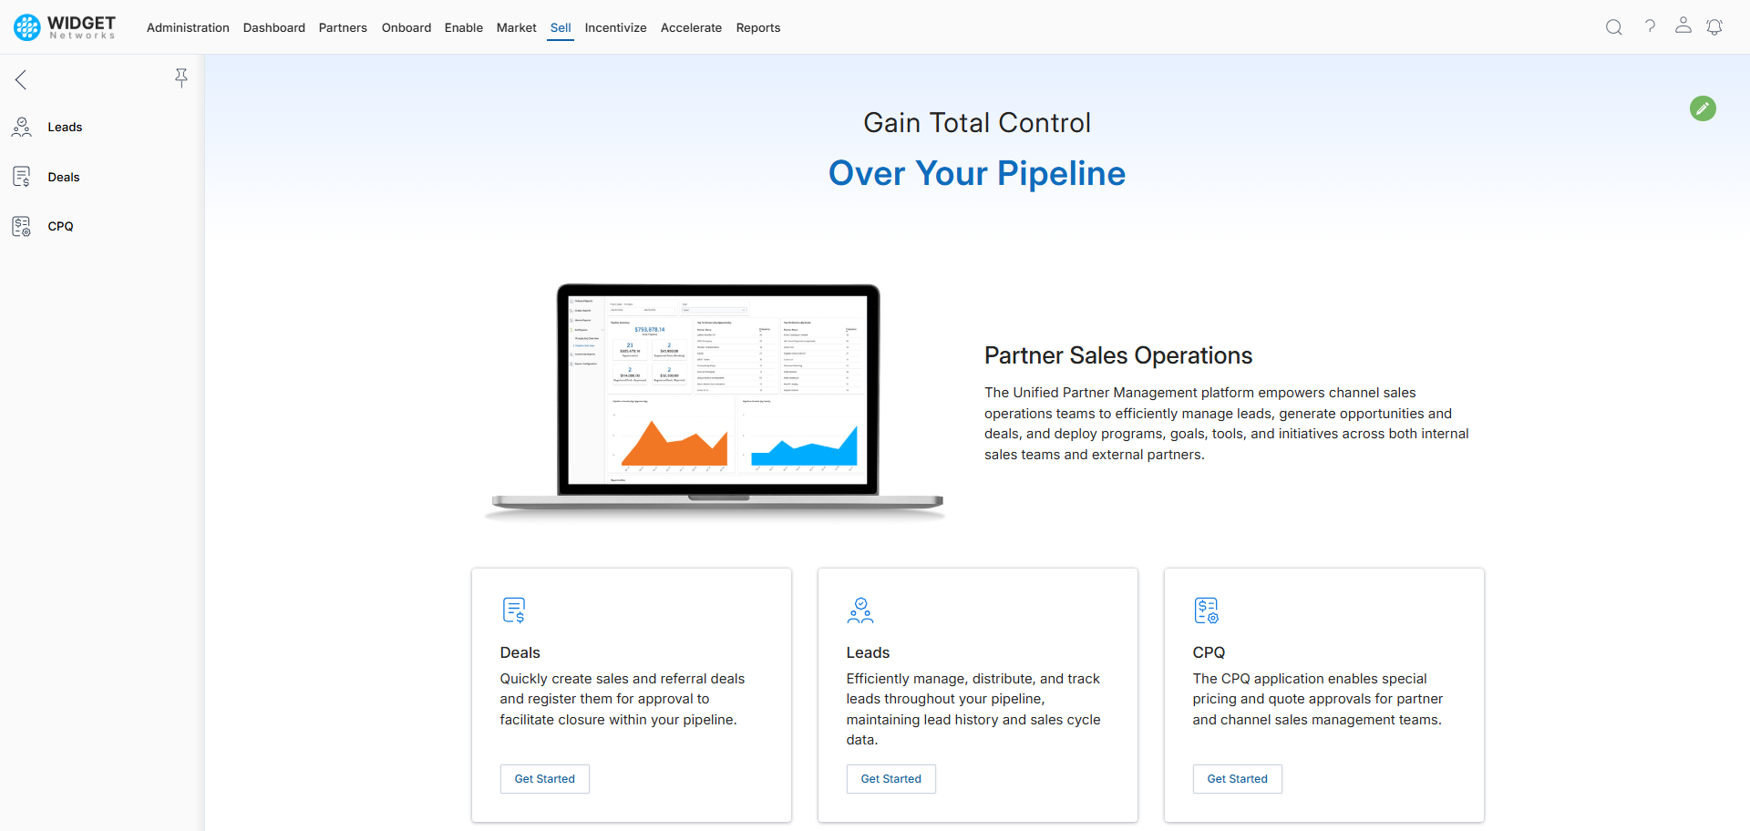
Lead Management Platform
Supplier Led
Contact to Close
  Distribute based on factors
      Competencies
      Verticals
      Sizes, etc.
  Separate lead by maturity
Management
  Allocate
  Notify/Alert
  Reallocate
Measure
  % Partner Adopting
  % Conversion by Stages
  Pipeline Built by Segment
  Etc.

Slide 9
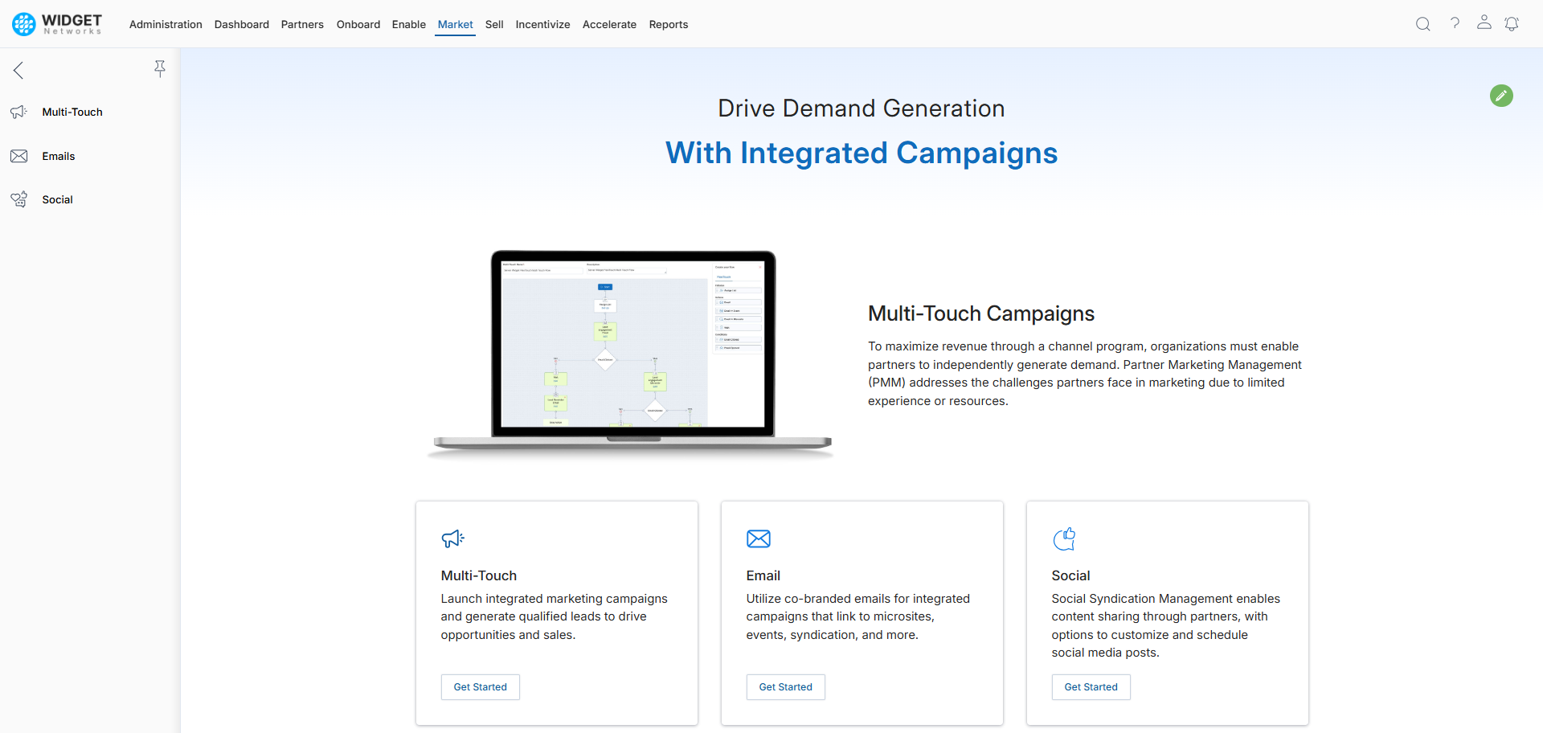
Lead Generation Platform
Partner Led
List Management
  Partners to upload lists
  Confidential and secure
  Contact to Close (stage management)
Campaign Management
  Multi-touch Campaigns
  Co-branded Asset Sharing
  Dynamic Lead Alerts
Performance Management
  Campaign Performance
  Partner Performance
  Pipeline Development

Slide 10
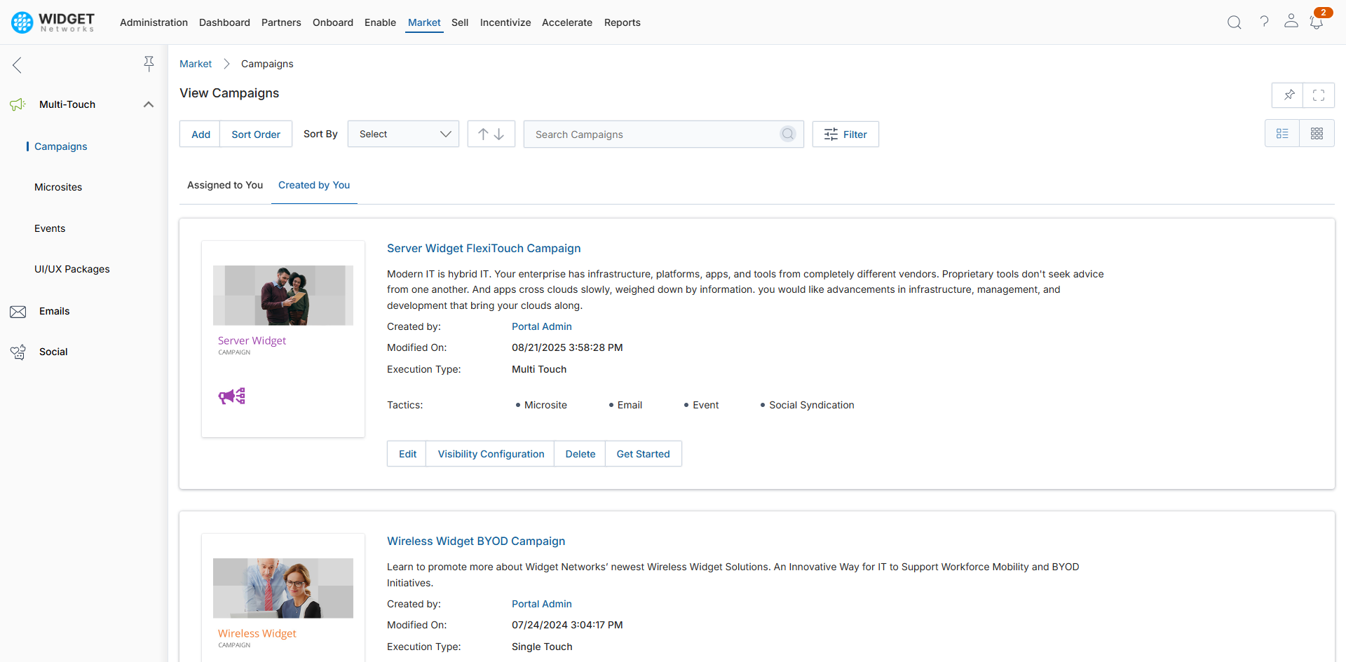
Lead Generation Platform
Partner Led
Pre Packaged Campaigns
Campaigns In A Box
  Single-Tactic (SMB)
  Multi-Tactic (Mid-Market/Enterprise)
  Co-brandable
Group Based Access
  Language & Group Filter
  Time Based Expiration
Marketing Services
  Concierge Services
  Country Based Services
  MDF & Incentives Policies

Slide 11
Lead Management Process
Process Example
Will you (OEM) manage your leads in ZINFI UPM or in your CRM (with ZINFI UPM Connector)?
Leads Loaded/Reside in CRM Instance
Leads Loaded/Reside in ZINFI UPM
Leads Passed to Partner/Group
Leads Passed to Partner/Group
Partner Has Accepted Lead
Partner CRM Configured?
Y
Lead Received into Partner CRM
N
SYNC
Lead Nurtured by Partner
SYNC
Lead Nurtured by Partner
Lead Converted to Opportunity
Opportunity Synced
Opportunity Pushed to OEM CRM
Lead Converted to Opportunity
Deal Registration
Deal Approval Process
Deal Approval Process
Activity Reporting
OEM CRM
ZINFI UPM
PARTNER CRM

Slide 12
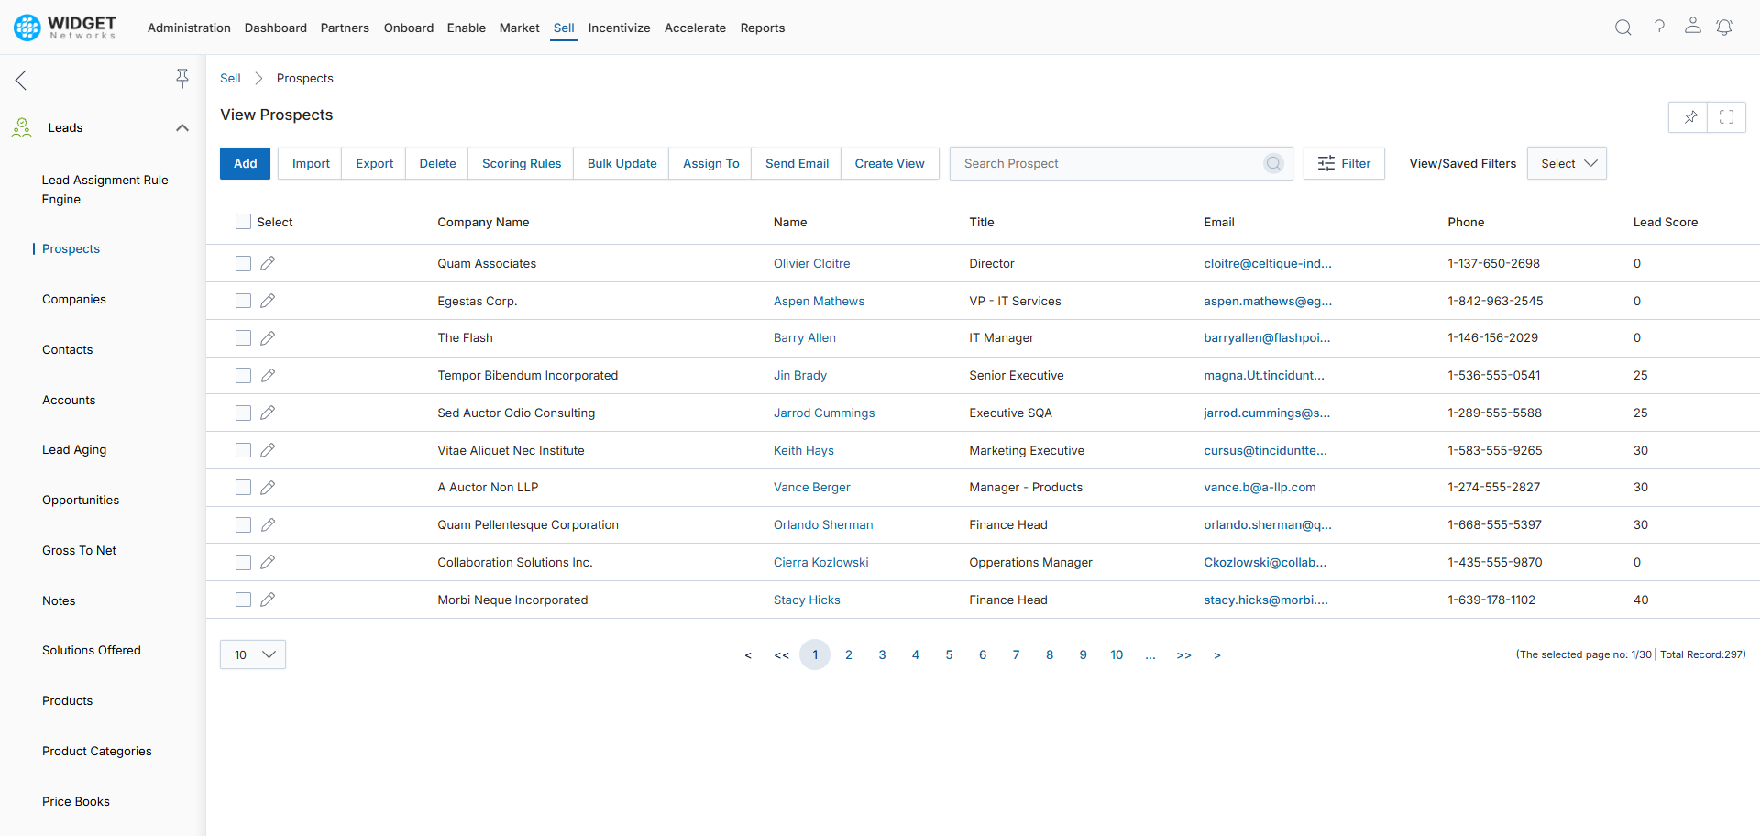
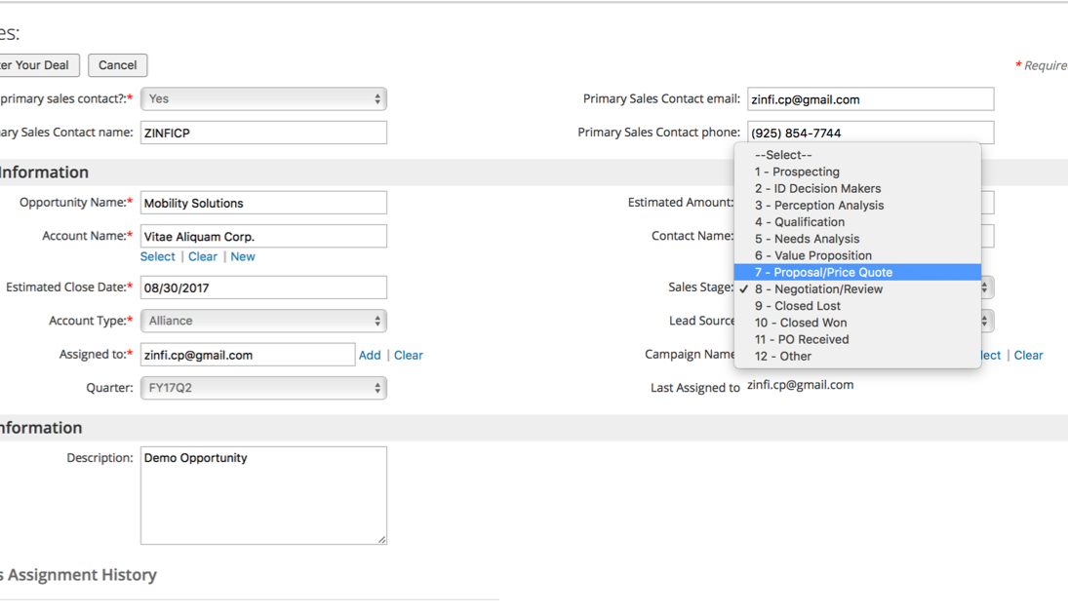
Process Automation
Contact to Close
Track by Various Parameters
Track by Sources
Track by Various Stages
Two Primary Types – Open Accounts (Shark Tank) or Named Accounts

Slide 13





Concierge (People) Support
Digital Enablement
Teaching Partners The Buyers Journey
Marketers seek those touch points when consumers are open to influence. In today’s highly digitized world, the traditional funnel method fails to capture all the touch points and key buying factors that result from the explosion of product choices, digital and social media channels, coupled with the emergence of an increasingly discerning, well-informed consumer.
What are your customers’ needs?
How does
your offering meet your customers’ needs?
Ready to purchase!
Awareness
Interest
Consideration
Preference
Purchase
What can your customer do
to fulfill these needs?
How do we
create an inclination
towards
our offered solution?
Critical Milestones
13

Slide 14
Concierge (People) Support
People
Level 1
Inbound Support
Predefined scope to provide support to partners related to portal support, lead management program details, MDF details, training, etc.
Discuss relevant marketing and sales tools to nurture prospects and grow pipeline
Enable partners to run multi-touch campaigns by using pre-packaged campaign content
Level 2
Outbound Support
  Localized marketing concierge performed on behalf of the vendor to partners – Market To
  Includes outbound active engagement via group webinars, training, etc., to drive strategic program adoption
  Includes also one-on-one coaching sessions post group onboarding and training sessions to drive adoption
  Typically provided to a focused list of top and mid-tier partners with finite goals and objectives
Level 3
Campaign Packages
  Marketing concierge performed to end-user-prospects on behalf of the partners – Market Through
  Predefined single or multi-tactic campaigns with pre-loaded content
  Deployed typically for top and mid-tier partners, but can be made available to others
Level 4
Custom Programs
  Fully a la carte creative and marketing services with pre-approved rate cards
  Deployed for Top-tier partners only with available MDF
  ZINFI concierge drives end to end execution once program scope defined and funded by the vendor or partner
For top strategic partners
Focus on demand generation primarily pre-funded or MDF funded
Deployed to a focused set of partners to drive adoption of campaigns, promotions, incentives, training, etc.
Can be made available to the entire partner base to provide more bandwidth to existing channel teams

Slide 15
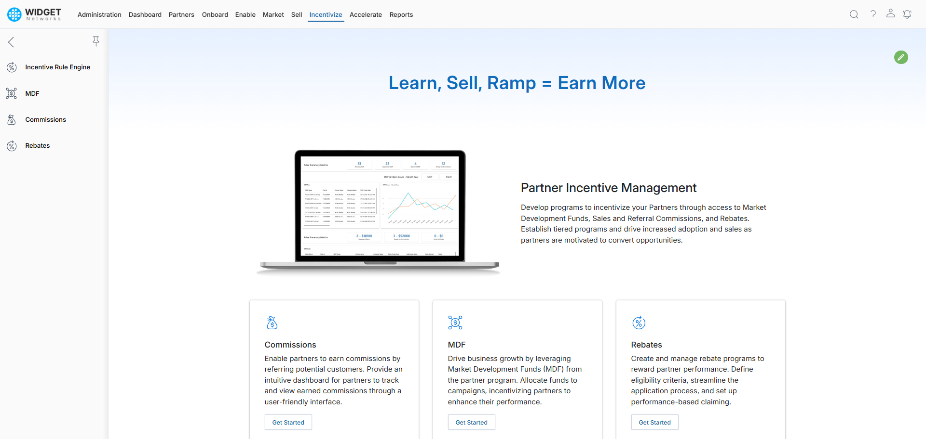
Incentive Programs
Performance Incentives
Company Rewards
  Special Rebates
  Referral & Commissions
  Market Development Funds
Personnel Rewards
  Technical Excellence
  Marketing Excellence
  Sales Excellence
Dynamic Reports & Alerts
  Leaderboards
  Accelerators

Slide 16
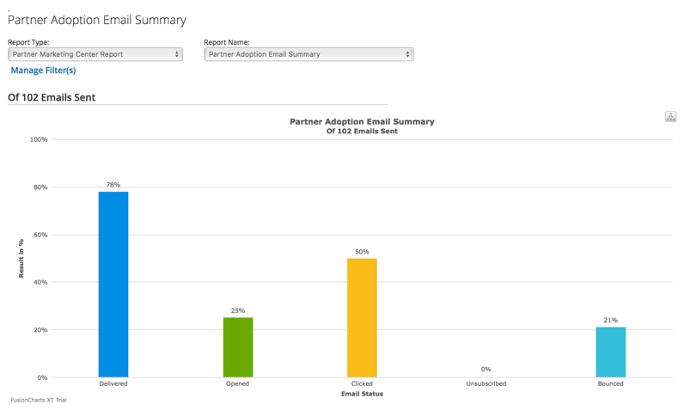
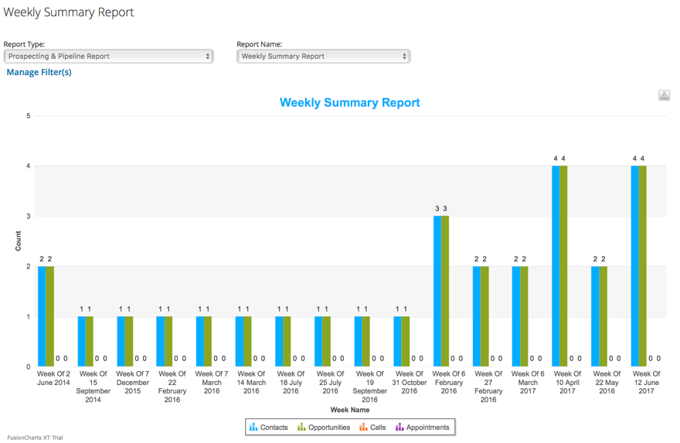
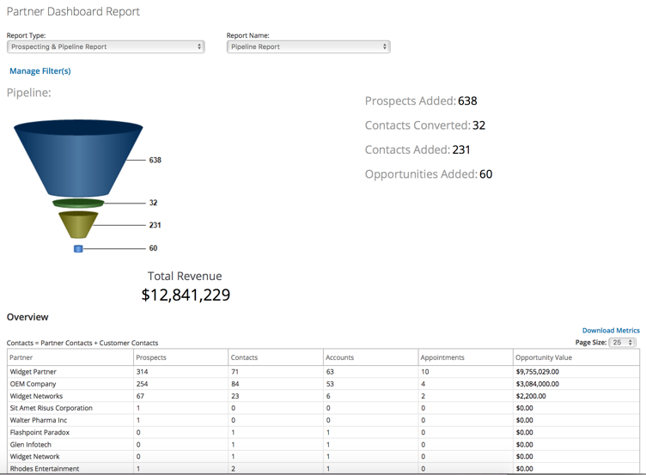
Performance Reporting
Track, Measure, Manage
Engagement Report
  Partner Adoption
  Program Effectiveness
  Success Hot Spots
Performance Report
  Lead Gen Report
  Opportunity Report
  Deal Reg & Pipeline Report
Custom Report
  Dynamic Capability
  Top Down Drill Down
  Automated Report Delivery
Track Partner Program Adoption
Track Partner Program Adoption
Track Pipeline & Opportunities
Notes:
…all these fours are now fully automated through one unified interface where you can track reporting at various levels to track one of the most important outputs of how much pipeline are they generating, what is closing, why some partners are doing well, why some partners need help, what do you need to change, and what you need to keep doing.
That insight, in an integrated way, is a best-in-class, Partner Relationship Management approach that allows any vendor not only to reduce costs and increase sales velocity, but also it attains a higher amount of partner engagement and loyalties because you have simply laid out a way of doing business that most of your competitors are possibly not doing with their partner base.
So with the dynamic dashboard (CLICK), you set up reports (CLICK), track what's going on (CLICK), take steps and continue to make progress based on data and facts that results in lowering costs by increasing engagements across your partner base, by increasing satisfaction and most importantly, by increasing sales.
-CHANGE SLIDE

Slide 17
Customer CRM to ZINFI UPM Integration

Slide 18

Inter System Communication Flow
Overview
Workflow Rule
Outbound Message
Listener
Queue
Application
User
Create or update
Call Outbound Message
Message XML
Message XML
Acknowledgment
Call Application
Acknowledgment
Process
Response()
Update Outbound Message Queue
OEM CRM
ZINFI UPM
Notes:
1. A DML update or insert occurs on a given set of records in CRM.
2. A CRM workflow rule triggers, based on a given set of conditions.
3. This workflow rule invokes a pre-configured outbound message that sends a SOAP-based message to a remote listener.
4. The remote listener receives the SOAP message, places the message on a local queue, and returns a positive acknowledgment to
CRM as part of the same transaction context.
5. The queuing application forwards the message to the remote application for processing.
6. CRM receives the acknowledgment and completes the request, but doesn’t wait for the application to process the
message.
7. CRM waits for an acknowledgment from the system for up to 10 seconds. After 10 seconds, CRM retries sending
the outbound message request for up to 24 hours.
In the case where the system must perform operations against CRM, you can implement an optional callback operation.
The outbound message sends a SessionId that you can use in the callback to authenticate and authorize an API or web service call into
CRM.

Slide 19
UPM to CRM Communication
Overview
Application
API
Object
Event
Login()
sessionid
Query()
Process Response()
Insert, update, Delete
Process Response()
Response()
ZINFI UPM
OEM CRM
Notes:
The application of the solutions related to this pattern allows for:
• UPM system to call the CRM APIs to query the database and execute single-object operations (create, update, delete, and
so on).
• UPM system to call custom-built CRM APIs (services) that can support multi-object transactional operations and custom
pre/post processing logic.
The UPM system authenticates before accessing any Apex REST service. The UPM system
uses OAuth 2.0 or username/password authentication. In either case, the client sets the
REST API
authorization HTTP header with the appropriate value (an OAuth access token or a session ID can
be acquired via a login call to SOAP API).
The UPM system then generates REST invocations (HTTP requests) with the appropriate verbs
and processes the results returned (JSON and XML data formats are supported).

Slide 20
Lead Management Flow
Best Practices

Slide 21

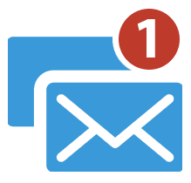


Work Flow
Industry Best Practices
Prospects submitted by Partner
Prospect Qualification Marketing Activities
Notes
Contact/Account Existing?
Tag with Existing Contact/Account
Y
Opportunity Synced as Lead
SYNC
N
Create Contact/Account
Lead Conversion & Approval Process
Lead Converted to Opportunity
Notes
Opportunity Pushed to OEM SFDC
Notes
Created/Failed Opportunity Status Pushed to UPM
Regd. Deal Submission Status
Notes
OEM CRM
ZINFI UPM

Slide 22
Description
Industry Best Practices
Activities Performed
Partner – Lead creation in UPM
Partner – Lead nurturing and conversion in UPM
Partner – Opportunity Addition in UPM
Automated Process – UPM Opportunity syncs as CRM Lead along
with contact, account and notes
CRM Admin – Lead conversion in CRM
CRM Admin – Opportunity approval in CRM
Automated Process – CRM opportunity status auto-updated in UPM
Mapped Modules
UPM | CRM
Opportunity | Leads
Accounts | Accounts
Contacts | Contacts
Notes | Notes
Registered Deals | Opportunity

Slide 23
System Configuration Decisions
Industry Best Practices
Basic
Sync Direction
  Uni-directional sync
  (CRM overwrites UPM)
Field Mapping
  Entire UPM form syncs with CRM
Access Rights
    Partner access UPM
    Admin access CRM
    CAM access CRM (occasional)
Email Alerts
    For approvals, status etc based on defined rules
Mobile App
    Replicates Desktop version rule set
Advanced
Sync Direction
  Bi-directional sync
  (both systems can overwrite based on last modified time stamp)
Field Mapping
  Selective Fields from UPM to CRM
Access Rights
    Partner access UPM and Partner CRM (occasional)
    Admin access both with primary access set based on changes to be made
Email Alerts
    For approvals, status etc based on defined rules
Mobile App
    Selective rule setup from the desktop version
Complete
Sync Direction
  Uni-directional sync
  (CRM overwrites UPM)
Field Mapping
  Selective Fields from UPM to CRM
Lead Distribution
    Lead assignment from CRM to UPM as Named or Open Accounts
Access Rights
    Partner access UPM and Partner CRM (occasional)
    Admin access both with primary access set based on changes to be made
Email Alerts
    For approvals, status etc based on defined rules
Mobile App
    Selective rule setup from the desktop version
Channel Maturity

Slide 24
Work Flow Use Case 1
New Account Addition & Approval

Slide 25
Work Flow
UC1 - New Account Addition & Approval
Contacts/Accounts
SYNC
Contacts/Accounts
Prospects submitted by Partner
Opportunity Synced as Lead
SYNC
Prospect Qualification Marketing Activities
Contact/Account Existing?
Notes
Tag with Existing Contact/Account
Contact/Account Approved?
Y
N
N
Y
Create Contact/Account
Contact/Account Existing?
Tag with Existing Contact/Account
Create Contact/Account
N
Y
Lead Converted to Opportunity
Lead Conversion & Approval Process
Opportunity Pushed to OEM SFDC
Notes
Notes
Created/Failed Opportunity Status Pushed to UPM
Regd. Deal Submission Status
Notes
OEM CRM
ZINFI UPM

Slide 26
Description
UC1 - New Account Addition & Approval
Activities Performed
Automated Process – Initial sync of CRM & UPM Account Database
Partner – New account creation in UPM
Automated Process – New UPM account auto syncs in CRM for
approval
CRM Admin – Initiates Account approval process in CRM
Automated Process – Approved account in CRM gets activated in
UPM
Partner – Opportunity submission in UPM with the
approved account
Mapped Modules
UPM | CRM
Accounts | Accounts
Notes | Notes

Slide 27
Work Flow Use Case 2
Campaign Tagging with Offer & Tactic ID

Slide 28
Work Flow
UC2 - Campaign Tagging with Offer & Tactic ID
Campaign Created based on synced Template
Campaign Template created
SYNC
Prospects generated through Campaign Execution
Prospect Qualification Marketing Activities
Notes
Contact/Account Existing?
Tag with Existing Contact/Account
Y
Opportunity Synced as Lead with Campaign Info.
SYNC
N
Create Contact/Account
Lead Conversion & Approval Process
Lead Converted to Opportunity
Notes
Opportunity Pushed to OEM SFDC with Campaign Info.(Tactic & offer ID)
Notes
Created/Failed Opportunity Status Pushed to UPM
Regd. Deal Submission Status
Notes
OEM CRM
ZINFI UPM

Slide 29
Description
UC2 - Campaign Tagging with Offer & Tactic ID
Activities Performed
Automated Process – CRM Campaign ID sync with UPM Campaign
Partner – Campaign Launch & Execution in UPM
Partner – Lead nurturing process initiated tagged with
Campaign ID, Offer ID and Tactic ID
Partner – Opportunity submission in UPM with all
tags
Automated Process – UPM Opportunity syncing in CRM with all
available tags
Mapped Modules
UPM | CRM
Campaign | Campaign
Opportunity | Lead

Slide 30
Work Flow Use Case 3
Lead Assignment to Partner

Slide 31
Work Flow
UC3 - Lead Assignment to Partner
Generated Lead
SYNC
Allocated Prospects
Prospect Qualification Marketing Activities
Notes
Contact/Account Existing?
Tag with Existing Contact/Account
Y
Opportunity Tagged to Lead
SYNC
N
Create Contact/Account
Lead Conversion & Final Approval Process
Lead Converted to Opportunity
Notes
Opportunity Pushed to OEM SFDC
Notes
Created/Failed Opportunity Status Pushed to UPM
Regd. Deal Submission Status
Notes
OEM CRM
ZINFI UPM

Slide 32
Description
UC3 - Lead Assignment to Partner
Activities Performed
CRM Admin – Lead creation in CRM
CRM Admin – Lead assignment to partner in UPM initiated
Automated Process – CRM lead syncing with UPM
Partner – View details of assigned lead
Partner – Lead nurturing process initiated in UPM
Mapped Modules
UPM | CRM
Prospect | Lead

Slide 33
Work Flow Use Case 4
Lead Assignment to Partner Groups
(Round Robin)

Slide 34
Work Flow
UC4 - Lead Assignment to Partner Groups (Round Robin)
Generated Lead
SYNC
Lead assigned to partner groups based on various criteria's (e.g. Region, Industry, Revenue etc.)
Partner Accept / Reject assigned lead
Lead Qualification Marketing Activities
Notes
Contact/Account Existing?
Tag with Existing Contact/Account
Y
Opportunity Tagged to Lead
SYNC
N
Create Contact/Account
Lead Conversion & Final Approval Process
Lead Converted to Opportunity
Notes
Opportunity Pushed to OEM SFDC
Notes
Created/Failed Opportunity Status Pushed to UPM
Regd. Deal Submission Status
Notes
OEM CRM
ZINFI UPM

Slide 35
Description
UC4 - Lead Assignment to Partner Groups (Round Robin)
Activities Performed
CRM Admin – Lead creation in CRM
CRM Admin – Lead assignment to partner group in UPM
initiated
Automated Process – CRM lead syncing with UPM
Automated Process – Lead assigned to partner groups based on
various criteria's (e.g. Region, Industry,
Revenue etc.)
Partner – View lead in Lead Inbox
Partner – Accept / Reject assigned lead
Partner – Lead nurturing process initiated for accepted
leads
Mapped Modules
UPM | CRM
Prospect | Lead

Slide 36
Work Flow Use Case 5
Lead Sync with Partner CRM

Slide 37
Work Flow
UC5 - Lead Sync with Partner SFDC
Generated Lead
SYNC
Lead assigned to Partner
View Lead Details and Assign to Partner Rep.
Lead Qualification Marketing Activities
Notes
Lead Converted to Opportunity
Opportunity Tagged to Lead
SYNC
Lead Conversion & Final Approval Process
Opportunity Pushed to OEM SFDC
(with Account, Contact)
Opportunity Pushed to ZINFI UPM
(with Account, Contact)
SYNC
Notes
Notes
Notes
Created/Failed Opportunity Status Pushed to UPM
Regd. Deal Submission Status
Approved Opportunity
Notes
OEM CRM
ZINFI UPM
PARTNER CRM

Slide 38
Description
UC5 - Lead Sync with Partner CRM
Activities Performed
CRM Admin – Lead creation in OEM CRM
CRM Admin – Lead assignment to partner in UPM initiated
Automated Process – OEM CRM lead syncing with UPM
Partner – View details of assigned lead
Partner – Lead assigned to Partner Rep in Partner
CRM initiated
Automated Process – UPM lead syncing with Partner CRM
Partner – Lead nurturing process initiated in Partner
CRM
Partner – Lead conversion to opportunity in Partner
CRM
Automated Process – Partner CRM opportunity with contact and
account auto syncs in UPM with Opportunity,
Account & Contact
Automated Process – UPM Opportunity syncs as lead in OEM CRM
Mapped Modules
UPM | OEM CRM | Partner CRM
Prospect | Lead | Lead
Opportunity | Leads | Opportunity
Accounts | Accounts | Accounts
Contacts | Contacts | Contacts
Notes | Notes | Notes
Registered Deals | Opportunity | Registered Deals

Slide 39
Configuration

Slide 40
Configuration Methodologies
Overview
Each integration scenario though unique, Configuration of the Systems is a common technique, applicable for the overall integration process.
This section describes configuration techniques at UPM end for integration scenarios. This will cover the following minimal configuration premises required at UPM end:
Account Management
CRM Mappings (Example Case: Salesforce)
Field Mappings

Slide 41
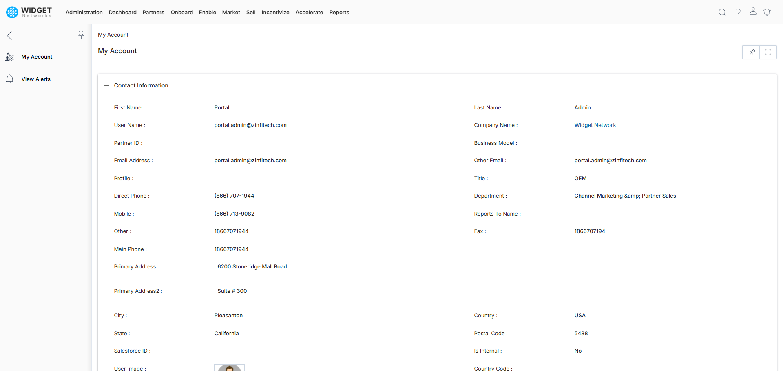
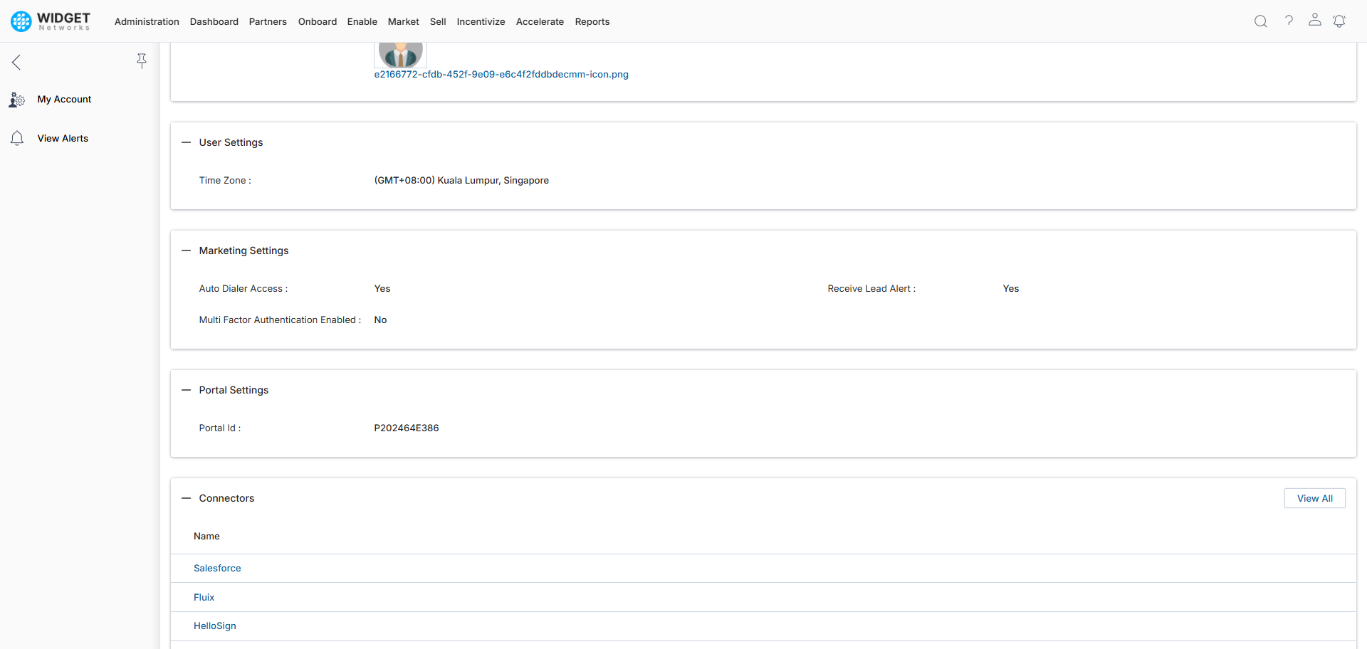
Account Management
Overview

Slide 42
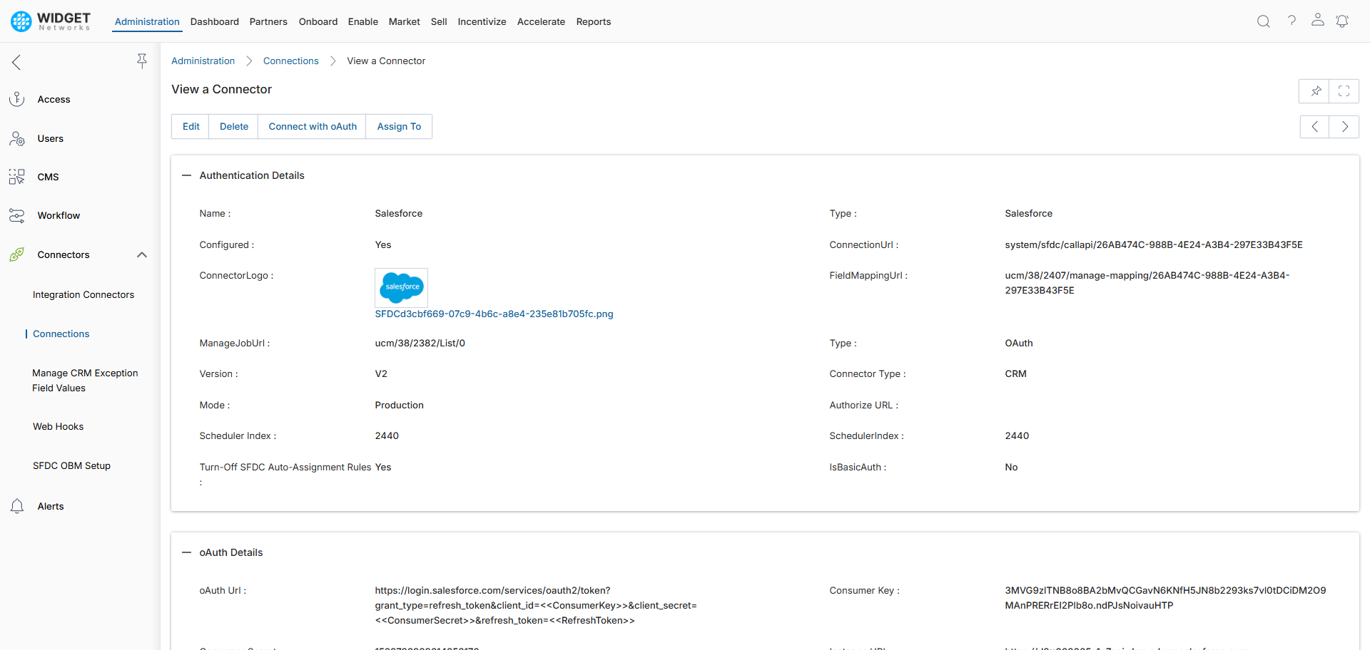
CRM Mappings
Overview

Slide 43
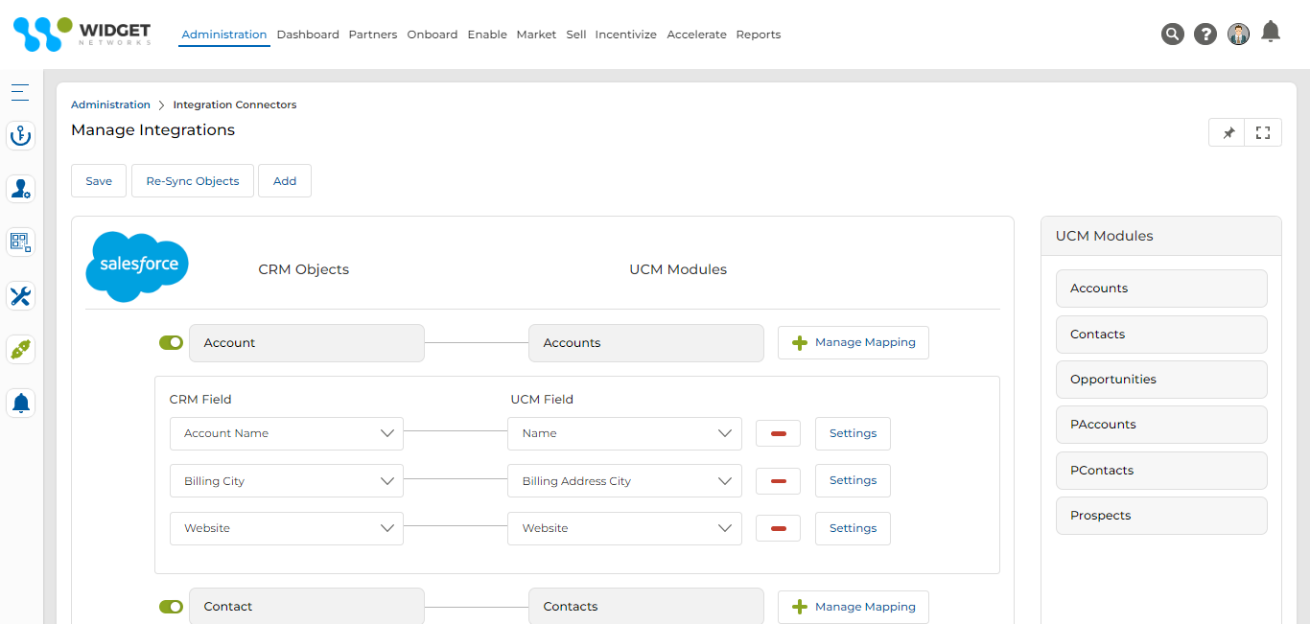
Field Mappings
Overview

Slide 44
Templates

Slide 45
Templates
Overview
The Templates for a basic integration process between CRM (Example Case: Salesforce) and UPM is being formulated as below:
View Leads List page at CRM
Leads Details page at CRM - Introduction of links using ZINFI Connector to Assign the Lead to Partner / Shark Tank
Lead Validation Criteria and Lead Assignment
CRM (Salesforce) Assigned Leads at UPM

Slide 46
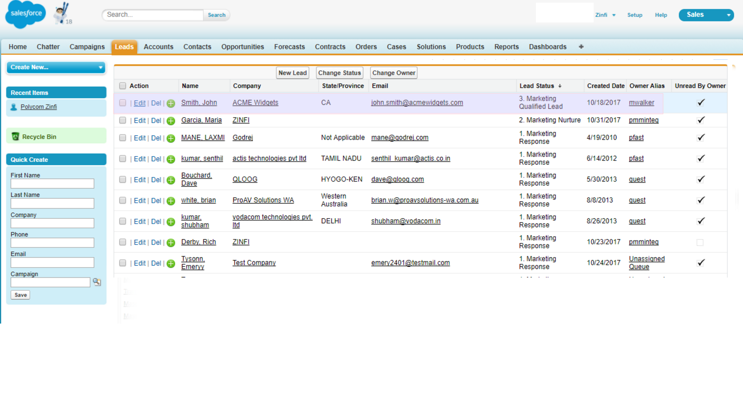
Leads Listing
Overview

Slide 47
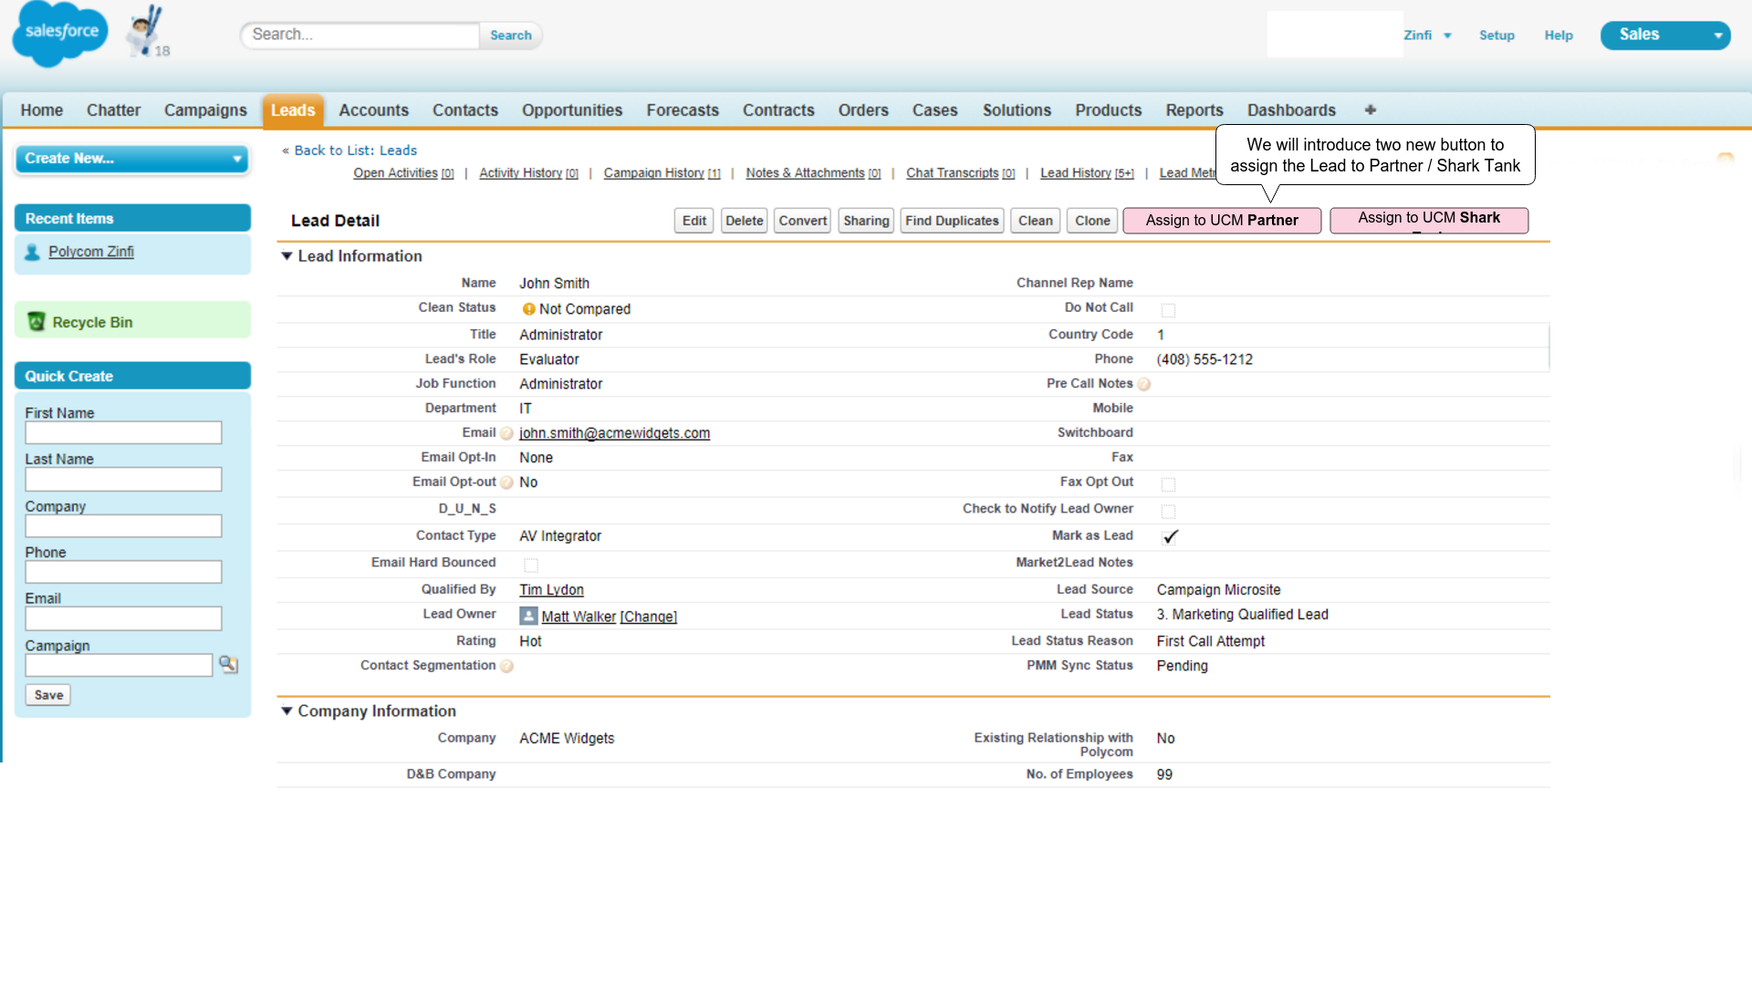
Lead Details
Overview

Slide 48
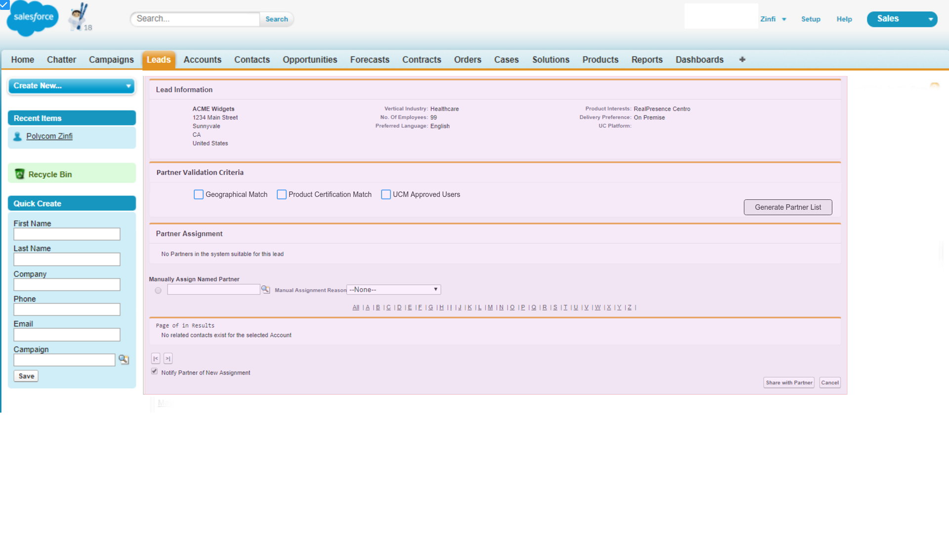
Lead Assignment
Overview

Slide 49
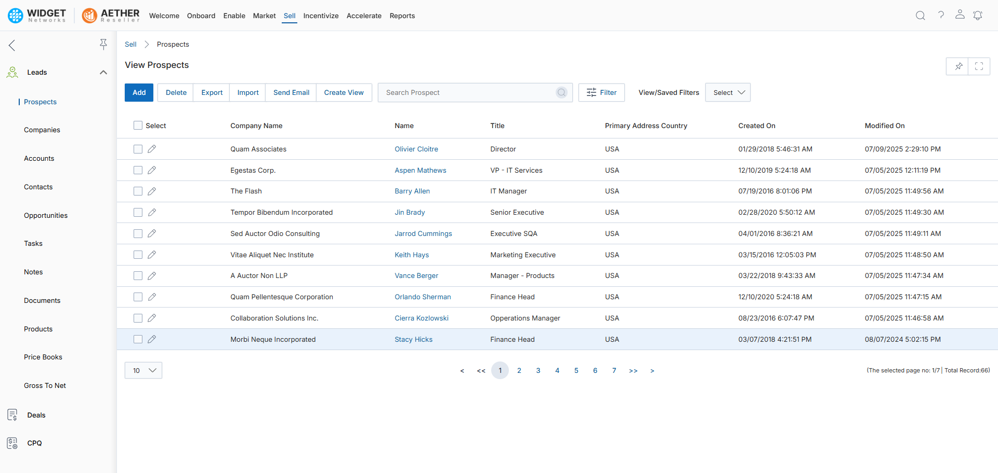
CRM Assigned Leads at UPM
Overview

Slide 50
Typical Implementation
Timeline

Slide 51
Typical Implementation Flow
Less WF = Less Time
Core Steps | 1 | 2 | 3 | 4 | 5 | 6 | 7 | 8 | 9 | 10 | 11 | 12
Basic Work Flow | x
Use Case Work Flow 1 |  | x
Use Case Work Flow 2 |  |  | x
Use Case Work Flow 3 |  |  |  | x
Use Case Work Flow 4 |  |  |  |  | x
Use Case Work Flow 5 |  |  |  |  |  | x
Integration Strategy |  |  |  |  |  |  | x | x
Screen & Flow Moqups |  |  |  |  |  |  | x | x
Integration |  |  |  |  |  |  |  | x | x | x
Testing |  |  |  |  |  |  |  |  |  | x | x
Release |  |  |  |  |  |  |  |  |  |  |  | x

